Slide 1
Protecting Sonoma County Immigrant Families
Presentation to the Grantmakers Concerned with Immigrant and Refugees
March 10, 2021
Margaret Flores McCabe, Executive Director
Bruce Goldstein, Secure Families Fund Trustee

Slide 2
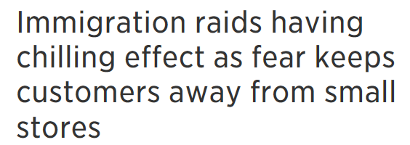
2017 Headlines - Campaign of Fear

Slide 3
Our Partners
Vital Immigrant Defense Advocacy and Services
VIDAS offers pro-bono and low-cost immigration legal services, including removal defense representation.
University of San Francisco (Deportation and Defense Law Clinic)
The Clinic opened a Collaborative office in Healdsburg to provide removal defense and affirmative relief.
Santa Rosa Junior College
In partnership with VIDAS, SRJC offers pro-bono and low-cost immigration legal services to students, faculty and staff through a Collaborative attorney, located adjacent to the school’s Dream Center. Undocumented student emotional support groups to resume when in-person classes back in session.

Slide 4
Humanidad Therapy and Education Services
Offers group convivencias and individual therapy sessions and acts as the Collaborative’s fiscal sponsor.
Catholic Charities of the Diocese of Santa Rosa
Sponsor the Collaborative’s Resource Navigator, who assists clients with access to wraparound social services.

Slide 5
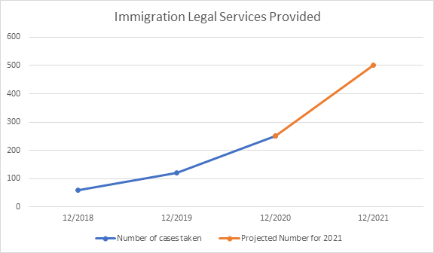
Our Work and Accomplishments
Since 2018, we have served over 600 individuals and around 250 immigration legal cases.
Removal defense cases are complex and can take 2 to 9 years to resolve.
We anticipate increased service demand due to the immigration reform under the Biden Administration.

Slide 6
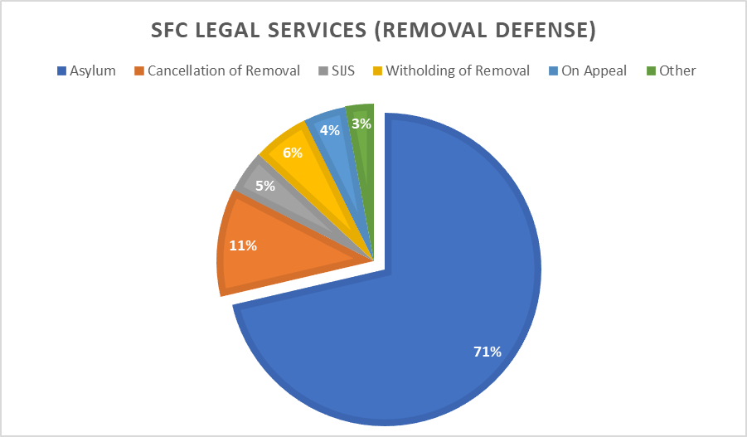
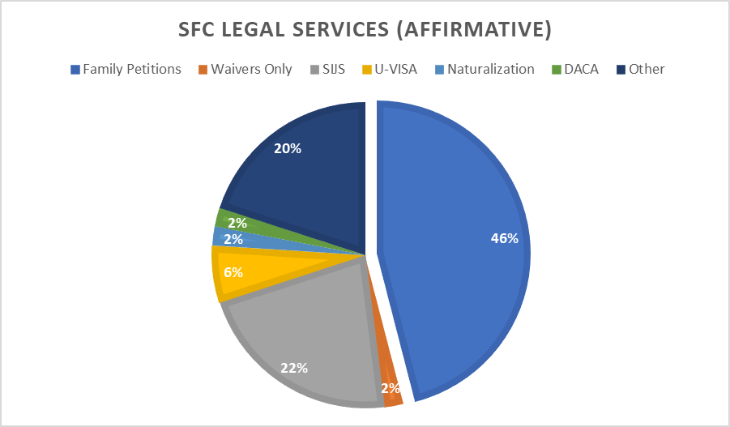
Breakdown of Immigration Legal Services
A sampling of 100 removal defense cases and 100 affirmative cases provided in 2020
Common removal defense cases: Asylum and Cancellation of Removal
Common affirmative cases: Family Petitions (e.g. Adjustment) and SIJS

Slide 7
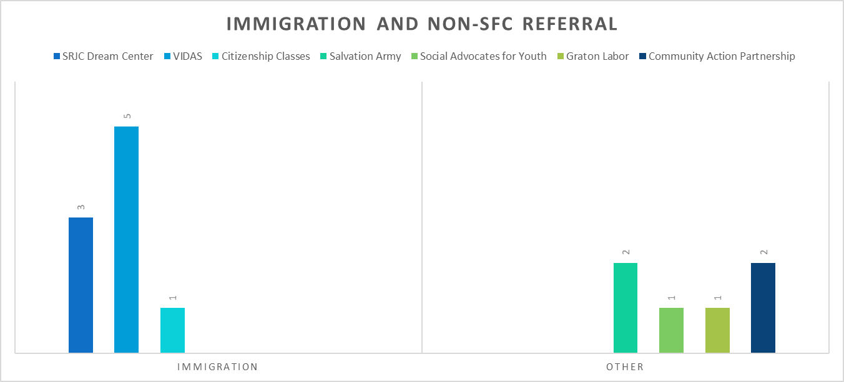
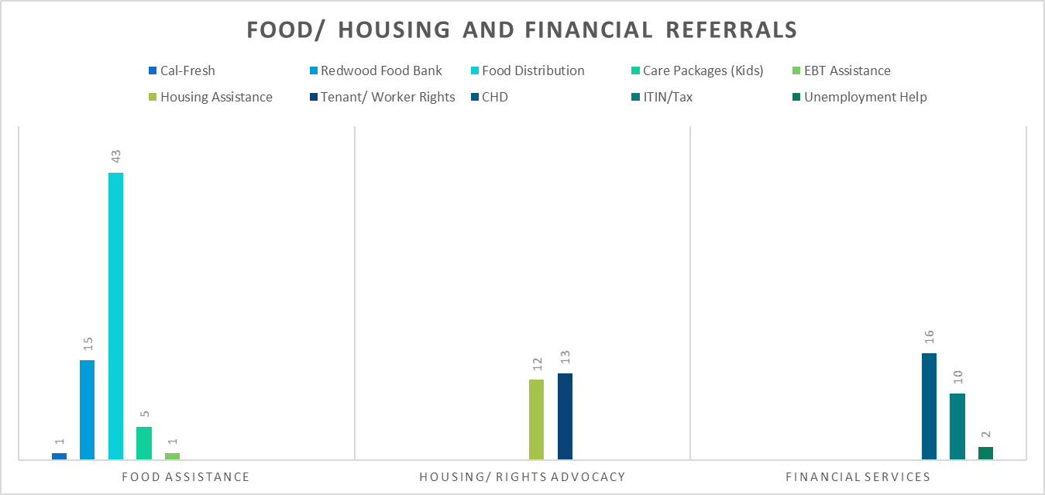
Breakdown of Immigration/ Social Services Referrals

Slide 8
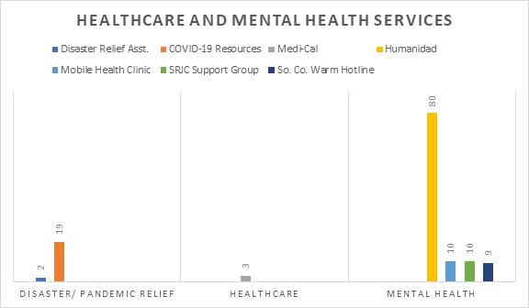
Breakdown of Mental Health/ COVID Relief Referrals

Slide 9
2021 Headlines - Campaign of Hope?

Slide 10
What is coming for 2021?
Immigration Legal Services System
Legal Aid of Sonoma County
California Human Development
Immigration Institute of the Bay Area
Vital Immigrant Defense Advocacy and Services
USF Deportation and Defense Clinic
Sonoma County Public Defender
Catholic Charities
Private Counsel
Expanded Social Services
La Luz Center
North Bay Organizing Project
Corazon Healdsburg
Redwood Community Health Coalition
SRJC Petaluma Campus

Slide 11
Strengthening Collaborative Infrastructure
Meeting the challenges of new opportunities for secure legal immigration status
Establish the Collaborative as a backbone organization to Sonoma County partners to support collective efforts
Strengthen organizational infrastructure through completion of strategic planning process
Plan convenings of legal services providers to assess the need for action for the immigrant community
Non-profit incorporation

Slide 12
Contact the Collaborative:
1260 N Dutton Avenue, Suite 230, Santa Rosa, CA 95401
Executive Director Margaret McCabe:
Email: mmcabe.socosecurefamilies@gmail.com
Phone: 925-698-8834
Visit our website:
www.sonomacountysecurefamilies.org

