Slide 1
All In This Together
Public-Private Partnerships to Support Our Undocumented Neighbors
May 22, 2020
.........

Slide 2
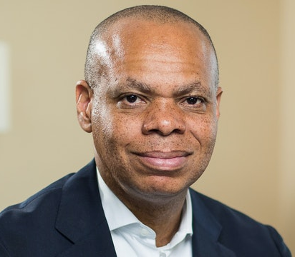
Welcome
.........
Patrick Gaspard
President
Open Society Foundations

Slide 3
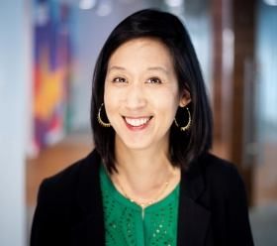
Moderator
.........
Carolyn Wang Kong
Chief Program Director
Blue Shield of California Foundation

Slide 4
Agenda Overview
.........
California
COVID-19 Disaster Relief For Immigrants, Kathleen Kelly Janus
California Immigrant Resilience Fund, Daranee Petsod
New York City Immigrant Relief Fund, Commissioner Bitta Mostofi
Harris County Covid-19 Relief Fund, Commissioner Rodney Ellis
Open Society Foundations, Laine Romero-Alston
Q&A
Closing

Slide 5
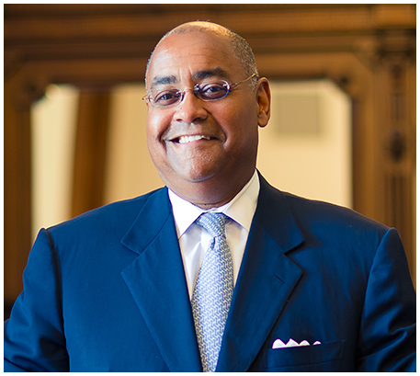
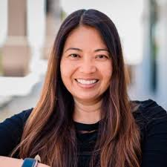
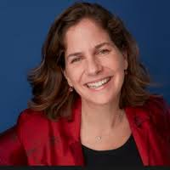
Speakers
.........
Patrick Gaspard
President
Open Society Foundations
Kathleen Kelly Janus
Senior Advisor on Social Innovation
Governor Gavin Newsom’s Office
Bitta Mostofi
Commissioner
NYC Mayor’s Office of Immigrant Affairs
Rodney Ellis
Commissioner
Harris County, Texas
Daranee Petsod
President
Grantmakers Concerned with Immigrants and Refugees
Laine Romero-Alston
Team Manager
International Migration Initiative

Slide 6
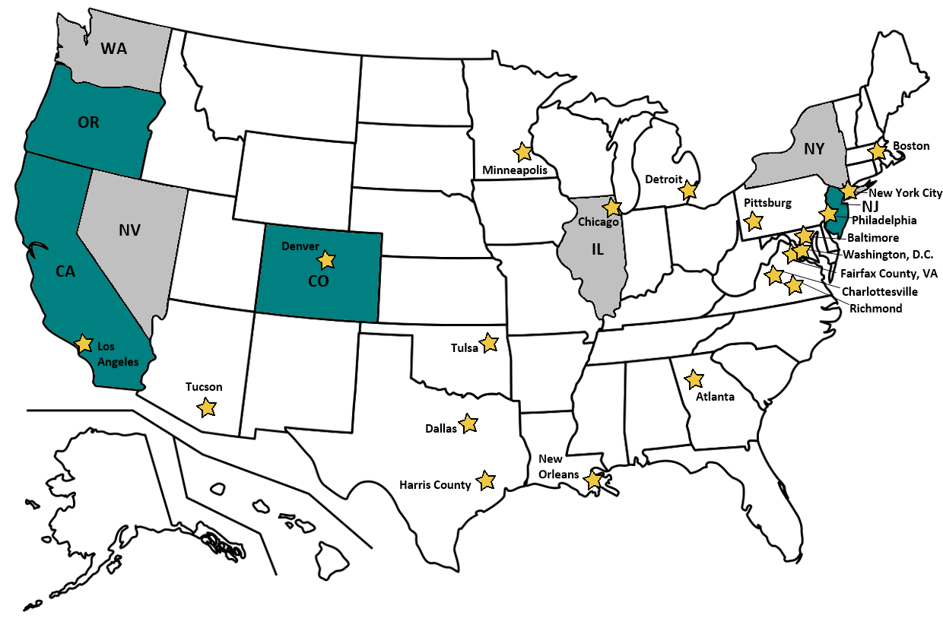

Slide 7
State of California
Coronavirus (COVID-19) Disaster Relief Assistance for Immigrants
.........
Kathleen Kelly Janus
Senior Advisor on Social Innovation
Governor Gavin Newsom’s Office

Slide 8
State of California
Coronavirus (COVID-19) Disaster Relief Assistance for Immigrants
One-time state-funded disaster relief assistance to undocumented adults who are ineligible for other forms of assistance, including assistance under the Coronavirus Aid, Relief, and Economic Security (CARES) Act and pandemic unemployment benefits, because of their immigration status.
This state funding is expected to reach about 150,000 undocumented adults.
The California Department of Social Services has selected twelve immigrant-serving nonprofit organizations to help individuals apply for and receive this disaster relief assistance in their region.
An undocumented adult who qualifies can receive $500 in direct assistance, with a maximum of $1000 in assistance per household. Eligible individuals must be able to provide information that they (1) are an undocumented adult (person over the age of 18); (2) are not eligible for federal COVID-19 related assistance, like the CARES Act tax stimulus payments or pandemic unemployment benefits; and, (3) have experienced a hardship as a result of COVID-19.
For more information: https://cdss.ca.gov/inforesources/immigration/covid-19-drai

Slide 9
California
.........
Daranee Petsod
President
Grantmakers Concerned with Immigrants and Refugees
Rodney Ellis
Commissioner
Harris County, Texas

Slide 10
Address structural inequities magnified by this pandemic
Leverage public funding and engage diverse funders
Create a statewide infrastructure for organizing and activating funders
Catalyze action across the country
Lay the groundwork for longer-term solutions

Slide 11
~40 CBO partners distributing cash assistance
Commitment to equity and justice
Underserved locales, e.g., rural communities
Hard-to-reach populations, API, Black, indigenous, LGBTQI
Complement state contractors and other relief funds
Allocation based on population size, existence of other relief funds, and donor designations
Distribution via checks and no-fee cash cards
Secure intake and reporting platform

Slide 12
$51M GOAL
$50M direct cash assistance
$1M for fiscal, fundraising, communications, disbursement, evaluation
$29.3M raised + $10M challenge grant
500+ individual donors
~30 foundations
~30 donor-advised funds
Rolling disbursement based on pledges received
$3.5M first round last week
$5M second round next week
Biweekly until all funds expended

Slide 14
An emergency relief fund is the starting point, not the end goal
Lay the groundwork for longer-term solutions
Expansion of unemployment, paid sick leave, health care, etc. for those currently ineligible
Increased protections for all workers
Organizing, advocacy, and movement building to dismantle structural inequities for all marginalized communities
Advance our vision of a just and equitable society where everyone thrives no matter where they were born

Slide 15
New York City Immigrant Relief Fund
.........
Bitta Mostofi
Commissioner
NYC Mayor’s Office of Immigrant Affairs

Slide 16
Why this Partnership?
Failure to include immigrant workers and families in Federal relief.
37.3% of New Yorkers are immigrants.
Of those, more than 350,000 are undocumented workers from a variety of backgrounds working in some of the most impacted industries – manufacturing, retail, service, hospitality, domestic care, transportation, construction.
NYC Undocumented Workforce by Region of Origin

Slide 17
Program Goals
Provide one-time emergency relief payments to up to 20,000 low-income New York immigrant families in need who have been excluded from federal stimulus relief efforts and unemployment insurance benefits.
Connect community members to services and programs they may be eligible for, including new or expanded programs addressing urgent needs such as food and burial assistance.
Support capacity in the field for the medium - to longer-term recovery.
Evaluation and advocacy

Slide 18
Program Structure
Funding
Provided by the Open Society Foundation.
Contracting and Program Management
The Mayor’s Fund is managing contracts and payments to program providers.
MOIA advised on partners and program design and is supporting the Mayor’s Fund by managing communications, reporting, and troubleshooting with providers.
Program Model and Fund Disbursement
Working with a network of over 30 CBOs and an additional 20 referral partners.
Provider CBOs are doing all outreach and eligibility screenings, with focus on outreach to existing clients or members, as well as referrals from trusted partners.
Provider CBOs also managing disbursement of relief funds, using anonymous, pre-paid debit cards.
Provider CBOs are submitting anonymous data to the City via and IRM for program management and evaluation.

Slide 19
How it Works: Eligibility
What makes a community member eligible?
1 | The applicant is a NYC resident who is experiencing financial distress due to the pandemic. | ✓
2 | The applicant is ineligible for the Federal CARES Act stimulus payment. | ✓
3 | The applicant is ineligible for unemployment insurance. | ✓

Slide 20
How it Works: Funding Categories
$1000
$400
Individuals
More than Two Adults and/or They Have Children
$800
Two Adults as a Unit

Slide 21
Lessons Learned
Administrative Challenges
Creating a stimulus relief program from scratch, need to move fast.
The scale of the need is greater than what we can currently provide.
Ensuring the privacy of the target population is key and presents many operational challenges.
Competing Priorities
Not to lose people for immediate and longer term recovery efforts.
Advocacy and evaluation goal vs capacity of organizations.

Slide 22
Contact Information
bmostofi@cityhall.nyc.gov
www.nyc.gov/immigrants

Slide 23
Harris County Covid-19 Relief Fund
.........
Rodney Ellis
Commissioner
Harris County, Texas

Slide 24
COVID-19 RELIEF FUND
HARRIS COUNTY
HELPING FAMILIES RECOVER
PRESENTER: COMMISSIONER RODNEY ELLIS

Slide 25
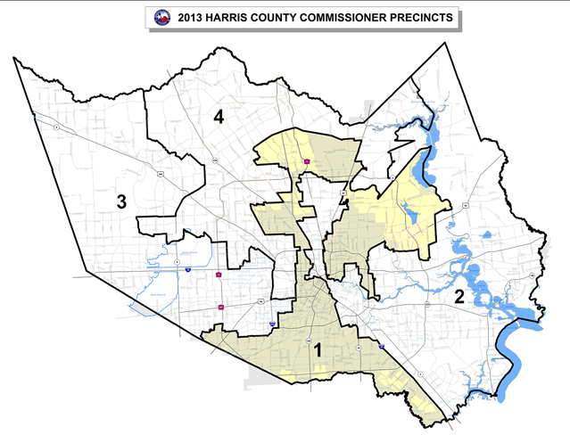
HARRIS COUNTY AT A GLANCE
Quick Facts:
4.5 million residents -Third largest county in the country.
Larger population than 26 states
City of Houston is the fourth largest in country.
Fifth highest population born outside the United States.
Economic Hardship in Harris County by the numbers
35%
24%
39%
31%
Had a problem paying for housing and food in the past year (2018)
Family has no health insurance (2019)
Could not come up with $400 for an emergency (2019)
Household income of less than $37,500 (2020)
Data from Kinder Institute for Urban Research at Rice University - AS OF APRIL 2020
1

Slide 26
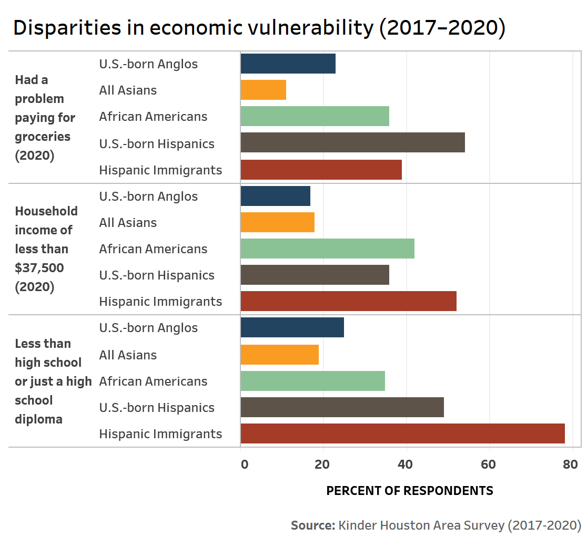
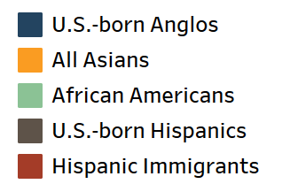
OUR IMMIGRANT COMMUNITIES
More than one quarter of the population in Harris County was born outside of the United States.
Mexican and Central American immigrants in our area have about half the median household income of their US-born neighbors and the poverty rate is almost twice as high.
The Urban Institute estimates that Harris County has lost more than 130,000 low-income jobs due to COVID-19.
2

Slide 27
FEATURES OF RELIEF FUND
PARTNERSHIP WITH THE GREATER HOUSTON COMMUNITY FOUNDATION
FUND DETAILS
$1200 - $1500 grants
Expected to help more than 20,000 families
Won’t discriminate based on immigration status
Assistance available beginning in June
BEST PRACTICES
Equitable distribution
Direct relief that provides flexibility to cover range of basic expenses
Targeted at most vulnerable – less than 60% area median income, homeless, youth aged out of foster care
Greater Houston Community Foundation managing fund. Experienced organization that has already vetted 100+ organizations that work with vulnerable communities
3

Slide 28
Perspective on Public-Private Partnerships
.........
Laine Romero-Alston
Team Manager
International Migration Initiative

Slide 29
Perspective on Public-Private Partnerships
Goals in linking direct relief to policy and systems response to step up to the scale of the moment
To get cash to people in desperate need—many of whom our societies are finally recognizing as essential workers—and yet who’ve been excluded from federal emergency support.
To encourage and support a nationally-connected cohort of local and regional public leaders, community and labor organizations, and philanthropic actors to openly stand up for essential but excluded workers, especially undocumented immigrants—and also to build alliances between public and private-sector actors in support of these populations.
To acknowledge the expertise and build the power of community-based groups like the National Domestic Workers Alliance and immigrant worker organizations on the ground- who advocate on behalf of immigrant and vulnerable workers—and to establish sustainable infrastructure so that governments, civil society, and local philanthropists can together serve vulnerable communities on a lasting basis.

Slide 30
Perspective on Public-Private Partnerships
Insights and Learning from Across the 20 Localities
Doing cash assistance is new at this scale. Opportunity to design for now in a manner that builds capacity for future fundamental.
Getting system right in a manner that delivers, is equitable, and sustainable is critical.
Legal and data hurdles are wicked.
Link of assistance to new solutions, policy advocacy and movement building can happen, requires intentionality.
Unprecedented moment to shape the narrative about what kind of society we are.

Slide 31
Q & A:
Please post your questions
in the chat box.

Slide 32
Key Takeaways and Closing
.........
Carolyn Wang Kong
Chief Program Director
Blue Shield of California Foundation

